Slide 1
Chasing the seconds 2.0 (Functions done right)
Thorsten Butz

Slide 2

Many thanks to our sponsors:

Slide 3

about_Session
{
"Title" : "Chasing the seconds 2.0",
"Subtitle": "Functions done right",
"Speaker" : "Thorsten Butz",
"Uri" : "thorsten-butz.de",
"Twitter" : "@thorstenbutz",
"Podcast" : "slidingwindows.de"
}

Slide 4
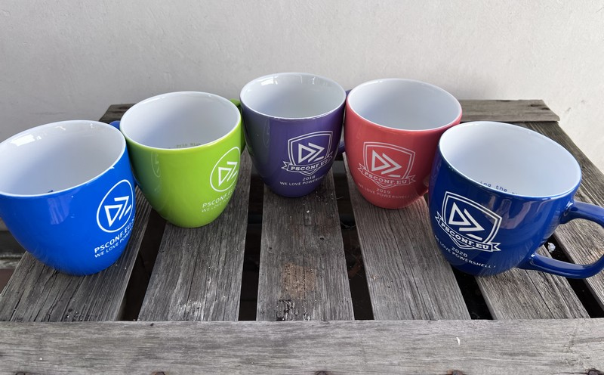
about_Mugs
(
)

Slide 5
Prologue

Slide 6
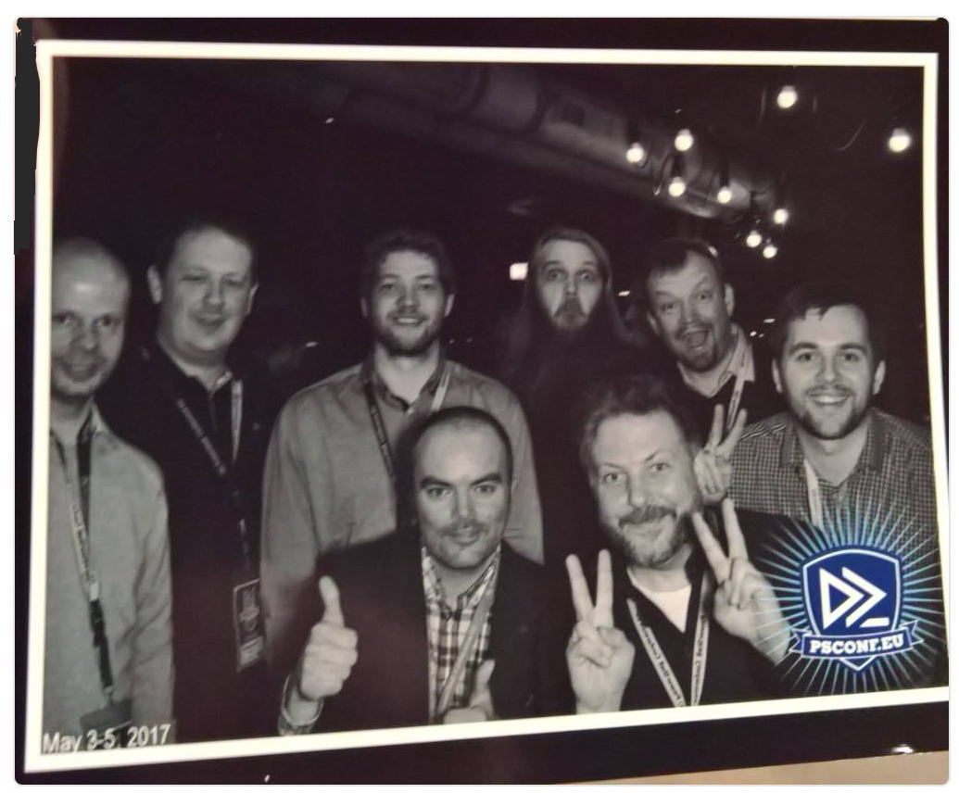
Chasing the seconds 1.0
PSConfEU 2016
Øyvind Kallstad

Slide 7
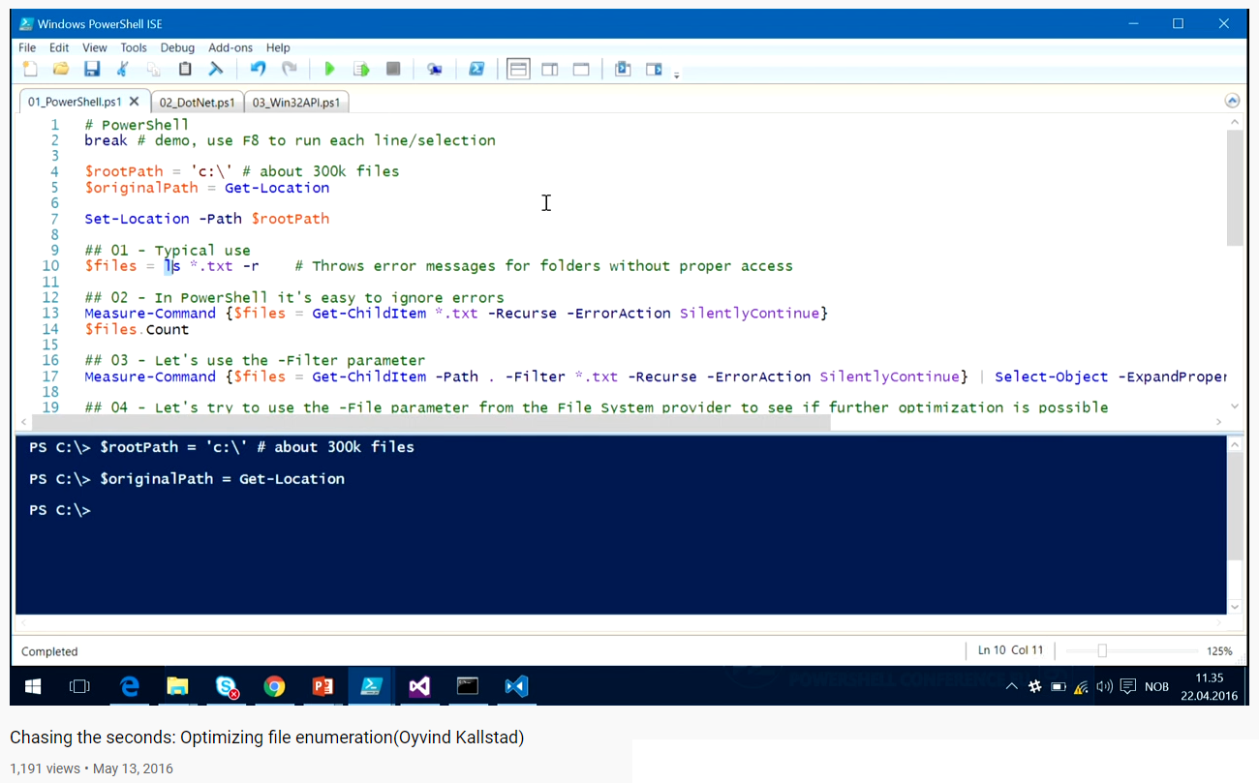
Chasing the seconds 1.0
https://youtu.be/erwAsXZnQ58
https://twitter.com/okallstad
https://github.com/psconfeu/2016/tree/master/Øyvind%20Kallstad

Slide 8
Basics

Slide 9
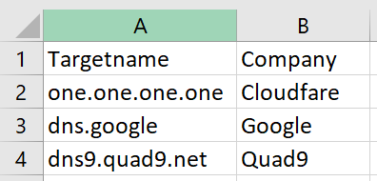
A well made cmdlet
$publicDNSServer = 'one.one.one.one','dns.google','dns9.quad9.net'
## A
Test-Connection -TargetName $publicDNSServer -TcpPort 53 -IPv4 -IPv6
## B
$publicDNSServer | Test-Connection -TcpPort 53
## C
Import-Csv -Path .\publicDNSServer.csv | Test-Connection -TcpPort 53

Slide 10
## Simple function
function foo {
param (
$bar
)
$bar * 23
}
foo -bar 42
## Advanced function (Script cmdlet)
function Invoke-Foo {
[CmdletBinding]
param (
$bar
)
$bar * 23
Write-Verbose -Message '(c) T. Butz'
}
Invoke-Foo -bar 42 -verbose

Slide 11
Demo A

Slide 12
In search of a blueprint

Slide 13
## Passing array as input
function Get-Honey {
[CmdletBinding()]
Param ([Parameter(
Mandatory
)]
[string[]] $Flower
)
Begin {
}
Process {
}
End {
}
}
## Pipeline support
function Get-Honey {
[CmdletBinding()]
Param ([Parameter(
Mandatory,
ValueFromPipeline,
ValueFromPipelineByPropertyName
)]
[string] $Flower
)
Begin {
}
Process {
}
End {
}
}

Slide 14
Example tasks
Get (basic) information about installed software
Get (basic) hardware information
PARENTAL
ADVISORY
SIMPLIFIED CONTENT

Slide 15
Example task 1
######################################################
## Registry: Get information about installed software
## (System-wide installations, basic version)
######################################################
$path = 'HKLM:\Software\Microsoft\Windows\CurrentVersion\Uninstall\*',
'HKLM:\Software\WOW6432Node\Microsoft\Windows\CurrentVersion\Uninstall\*'
Get-ItemProperty -Path $path |
Where-Object -Property 'DisplayName' |
Select-Object -Property 'DisplayVersion','DisplayName','UninstallString'

Slide 16
Example task 2
##################################################################################
## WMI: Get some basic system information
##################################################################################
$win32Bios = Get-CimInstance -ClassName Win32_BIOS
$win32OS = Get-CimInstance -ClassName Win32_Operatingsystem
[PSCustomObject] @{
'BIOSManufacturer' = $win32Bios.Manufacturer
'BIOSVersion' = $win32Bios.Version
'BIOSReleaseDate' = $win32Bios.ReleaseDate
'OSCaption' = $win32OS.Caption
'OSBuildNumber' = $win32OS.BuildNumber
'OSInstallDate' = $win32OS.InstallDate
'OSLastBootUpTime' = $win32OS.LastBootUpTime
}

Slide 17
Demo B

Slide 18
Measurement results
average values from 10 runs each
 | SoftwareInventory All PCs online | HardwareInfo(WMI) All PCs online | SoftwareInventory 50 % offline | HardwareInfo(WMI) 50 % offline
1 Array as input | 3809 ms | 1787 ms | 32924 ms | 32460 ms
2 Pipelining Process{} | 25934 ms ≈ 25 sec | 24698 ms ≈ 25 sec | 518134 ms ≈ 9 min | 519516 ms ≈ 9 min
3 Pipelining End{} | 3711 ms | 1658 ms ≈ 2 sec | 31480 ms | 37477 ms
4 Pipelining End{},Sessions | 2000 ms ≈ 2 sec | 1855 ms | 22500 ms ≈ 23 sec | 22386 ms ≈ 22 sec
5 Pipelining End{},Sessions, ValidateScript | 4817 ms | 4672 ms | 194415 ms | 193094 ms
6 CIMSession |  | 2689 ms |  | 22473 ms
Notes:
These measurements are based on a lab purely built on Azure consisting of a Windows Server 2022 domain controller and 48 Windows 10 clients with random software installed.
The measurement was made on Widnows 10 with PowerShell 7 remoting against PowerShell 5.1.

Slide 19

Summary
The "input processing methods" (begin/process/end-blocks) are IMPORTANT !
ValidateScript can be counter-productive (does not process async)
Be user-friendly: enable pipeling the smart way !
MIND THE BLOCKS

Slide 20
The blueprint
function Get-Honey {
[CmdletBinding()]
Param ([Parameter(
Mandatory,ValueFromPipeline,ValueFromPipelineByPropertyName
)]
[string[]] $Flower
)
Begin {
}
Process {
[string[]] $Flowers += $Flower
}
End {
# Asnychronous processing
Invoke-Bee -Destination $Flowers -ScriptBlock { Collect-Honey }
}
}
Notes:
# The "real" blueprint
function Invoke-Something {
[CmdletBinding()]
Param ([Parameter(
Mandatory,ValueFromPipeline,ValueFromPipelineByPropertyName
)]
[string[]] $Computername
)
Begin {
}
Process {
[string[]] $Computernames += $Computername
}
End {
# Asnychronous processing
Invoke-Command -Computername $Computernames -ScriptBlock { hostname }
}
}

Slide 21

KEEP
CALM
AND
ENJOY
#PSCONFEU
{
"Venue" : "PSConfEU 2022",
"Title" : "Chasing the seconds 2.0",
"Subtitle": "Functions done right",
"Speaker" : "Thorsten Butz",
"Uri" : "thorsten-butz.de",
"Twitter" : "@thorstenbutz",
"Podcast" : "slidingwindows.de"
}
Corbel 57, 28

